Slide 1
Trophic transfer of microplastics and associated POPs
Annika Batel
Centre for Organismal Studies (COS)
Aquatic Ecology and Toxicology
University of Heidelberg

Slide 2
Main objectives
the transfer of small MPs (1-20 µm) along artificial food chains, their fate, behavior and potential accumulation within higher trophic organisms;
the potential distribution in organismal tissue after transfer;
the potential to transfer elevated amounts of POPs (persistent organic pollutants) due to higher surface-to-volume ratios and accumulation processes.

Slide 3
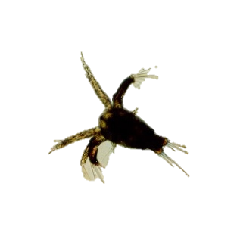
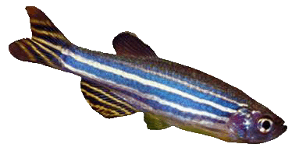
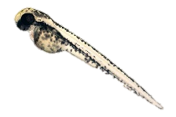
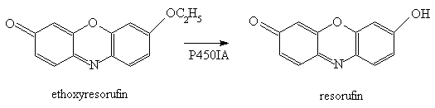


Toxic substance (PAHs etc.)
Artemia spec.
Zebrafish
Ingestion
of particles
Feeding
of Artemia
MPs
Desorption of substance into cells by adherence
Desorption of substance into gastric acid
Ah receptor
ARNT
Ethoxyresorufin-O-deethylase (EROD) activity by conversion of ethoxyresorufin to resorufin
CYP1A enzymes

Slide 4
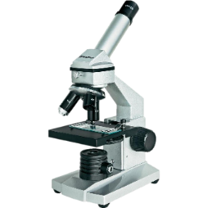
Material and Methods – Trophic transfer
Feeding to zebrafish
Dissection
3 h / 6 h
1-5 µm / 10-20 µm MPs fluorescently labelled
constant aeration
instar II nauplii
Control of MP uptake with epifluorescence
1, 7 and 14 days of feeding (chronic dietary exposure, twice daily)
Dissection of intestinal tract
Histological sections
Analyses on MP accumulation, fate and excretion
Batel et al. 2016, Environmental Toxicology and Chemistry

Slide 5
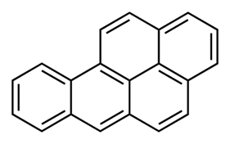
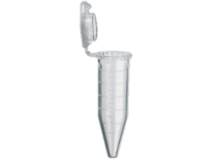
Material and Methods – POP transfer
benzo[a]pyrene (BaP)
Feeding to zebrafish
Dissection of liver
3 h / 6 h
1-5 µm / 10-20 µm MPs fluorescently labelled
constant aeration
instar II nauplii
Control of MP uptake with epifluorescence
Freezing in liquid N₂
Measurement of conversion of ethoxyresorufin to resorufin
Control groups: Negative control (without MPs and BaP), MP control (with MPs, without BaP), positive control (waterborne BaP)
Homogenization of liver samples
Batel et al. 2016, Environmental Toxicology and Chemistry

Slide 6
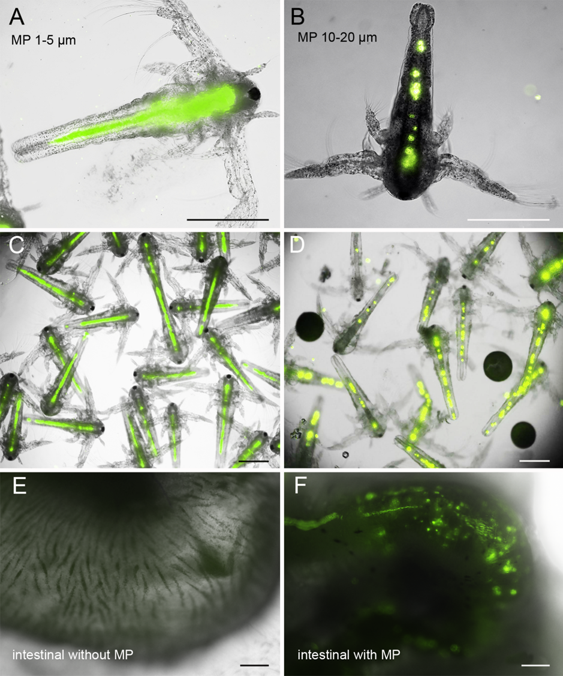
Establishment of food chain
Artemia nauplii with fluorescently labelled microplastics
Artemia spec. (Instar II): 90 % of nauplii with MPs ingested after 3h exposure
Adult zebrafish: MPs excreted after 4-6 h
Zebrafish intestinal tract after feeding nauplii with ingested microplastics
Batel et al. 2016, Environmental Toxicology and Chemistry

Slide 7
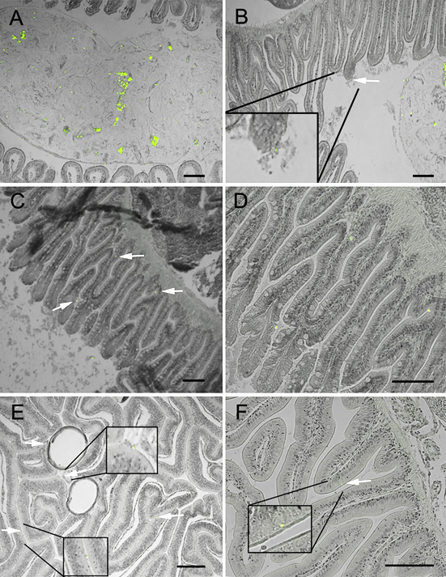
Establishment of the food chain
MPs passed intestinal tract of zebrafish within chyme
Only few particles passed chyme and were retained between intestinal villi
Chronic dietary feeding (2 weeks) showed no further accumulation
In three cases, MPs seemed to be taken up by epithelial cells of villi
Batel et al. 2016, Environmental Toxicology and Chemistry

Slide 8
POP transfer via MPs along food chain
Benzo[a]pyrene as model substance
Hepatic EROD assay
BaP fluorescence tracking

Slide 9
MP spiking with benzo[a]pyrene (BaP)
Since only 2-10 % of Bap was left in filter water compared to pure spiking solution, approx. 90 % of BaP attached to the MPs
MPs incubated overnight in BaP solution
MPs filtered, washed 3 x, re-dissolved in water
Filter water → GC-MS analyses of spiking process
After feeding with spiked MPs, nauplii freeze dried and extracted with cyclohexane in ultrasonic bath → GC-MS → estimate the amount of BaP fed to zebrafish
 |  | Area of peak in GC-MS | µg BaP | Estimate µg BaP fed in two days
filter water | 1 µmol BaP | 2162897 | 236 ± 59
 | MP 1-5 + 1 µmol BaP | 49653 | 5 ± 1
 | MP 10-20 + 1 µmol Bap | 191195 | 21 ± 5
nauplii after ingesting spiked MPs | 1-5 µm 3 h | 269699 | 29 ± 7 | 140 ± 34 | Water-borne positive controls: 1 µM (252 µg/L) 500 nM (126 µg/L)
 | 1-5 µm 6 h | 375565 | 41 ± 10
 | 10-20 µm 3 h | 87498 | 10 ± 2 | 62 ± 14
 | 10-20 µm 6 h | 194320 | 21 ± 5
Batel et al. 2016, Environmental Toxicology and Chemistry

Slide 10
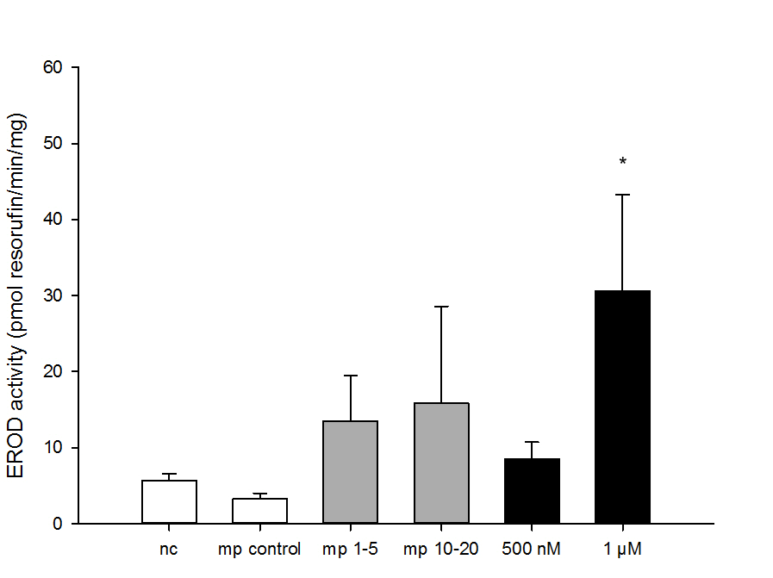
Feeding of benzo(a)pyrene coated microplastics and hepatic EROD assay
EROD activity after feeding on loaded microplastics:
Negative controls:
zebrafish not fed any microparticles (nc)
zebrafish fed microplastics without BaP (MP control).
Positive controls:
500 nM (500 nm BaP)
1 µM water-borne BaP (1 µM BaP)
Feeding for two days (twice daily) nauplii with ingested spiked MPs
Batel et al. 2016, Environmental Toxicology and Chemistry

Slide 11
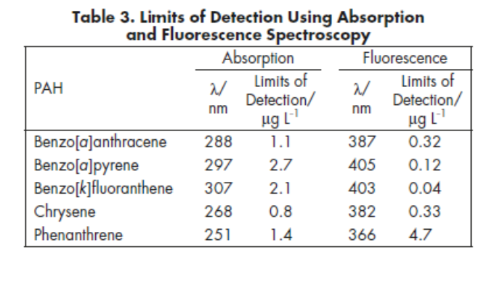
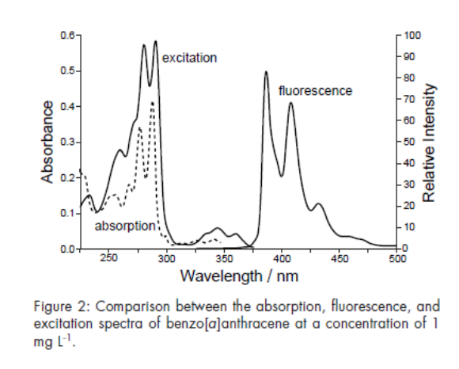
Fluorescence tracking of benzo(a)pyrene
Rivera-Figueroa et al. (2004): Fluorescence, Absorption, and Excitation Spectra of Polycyclic Aromatic Hydrocarbons as a Tool for Quantitative Analysis, Journal of Chemical Education
Plant et al. (1985): Cellular Uptake Benzo(a)pyrene and Intracellular Localization of by Digital Fluorescence Imaging Microscopy, The Journal of Cell Biology
→ Uptake of benzo(a)pyrene by living cultured cells has been visualized in real time using digital fluorescence-imaging microscopy

Slide 12
Fluorescence tracking of benzo(a)pyrene
BaP Emission peaks: 405 and 435 nm
DAPI channel:
Emission filter 435 – 485 nm
Fioressi et al. 2008

Slide 13
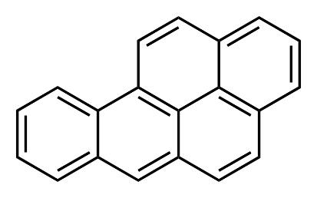
Fluorescence Tracking of benzo(a)pyrene
MPs loaded with benzo(a)pyrene (BaP), exicition filter 340-380 nm, emission filter 435-485 nm, visual detection of BaP in Artemia nauplii
Benzo(a)pyrene
Batel et al. 2016, Environmental Toxicology and Chemistry

Slide 14
Fluorescence Tracking of benzo(a)pyrene
MPs loaded with benzo(a)pyrene (BaP), exicition filter 340-380 nm, emission filter 435-485 nm, visual detection of BaP in cryo-sections of intestinal tracts of zebrafish
Benzo(a)pyrene
Batel et al. 2016, Environmental Toxicology and Chemistry

Slide 15
Fluorescence Tracking of benzo(a)pyrene
Vahakangas et al. (1985): An applied synchronous fluorescence spectrophotometric assay to study benzo[a]pyrene-diolepoxide-DNA adducts, Carcinogenesis.
Fluorescence emission maxima occurred at 382 nm for BPDE-DNA and at 379 nm for benzo[a]pyrene-tetrols and -triol, which are hydrolysis products of BPDE.
Shift from 405 to 380 nm!
Batel et al. 2016, Environmental Toxicology and Chemistry

Slide 16
Discussion
The number of MP particles used exceeded by far environmental concentrations (1.2 / 0.6 million particles per 20.000 nauplii)
There was no accumulation of MPs in zebrafish after chronic dietary exposure → chyme, no stomach in cyprinids
There might be the potential that small MPs pass intestinal epithelia by phagocytosis
Benzo[a]pyrene transfer was difficult to measure with hepatic EROD assay due to high individual variances. However, a tendency of induction was visible
Fluorescence tracking of benzo[a]pyrene visualized the transfer along with MPs to Artemia nauplii and zebrafish, where it accumulated in intestinal tract epithelia and liver

Slide 17
Perspectives
Analyse the transfer of BaP (and other substances) compared to waterborne exposure with exact chemical analyses of microplastics and POPs concentration
Analyse the metabolization of transferred BaP (and other substances) compared to waterborne exposure via fluorescence analyses
Long term chronic exposure of low concentrations of both microplastics and POPs
Establishment of additional food chains (Paramecium → juvenile zebrafish; ongoing)

Slide 18















Thank you! Questions?

